Slide 1

Dynamic Public Parking Pricing System Based on Real-Time Demand Prediction
CSA0925-PROGRAMING WITH JAVA
Research Scholar
D. Chand basha(192424218)
Ganeshram. M(192321060)
Monish. S(192311132)
Saveetha School of Engineering
Supervisor
Dr. Sivasankar C
Dept of CSE
Saveetha School of Engineering

Slide 2


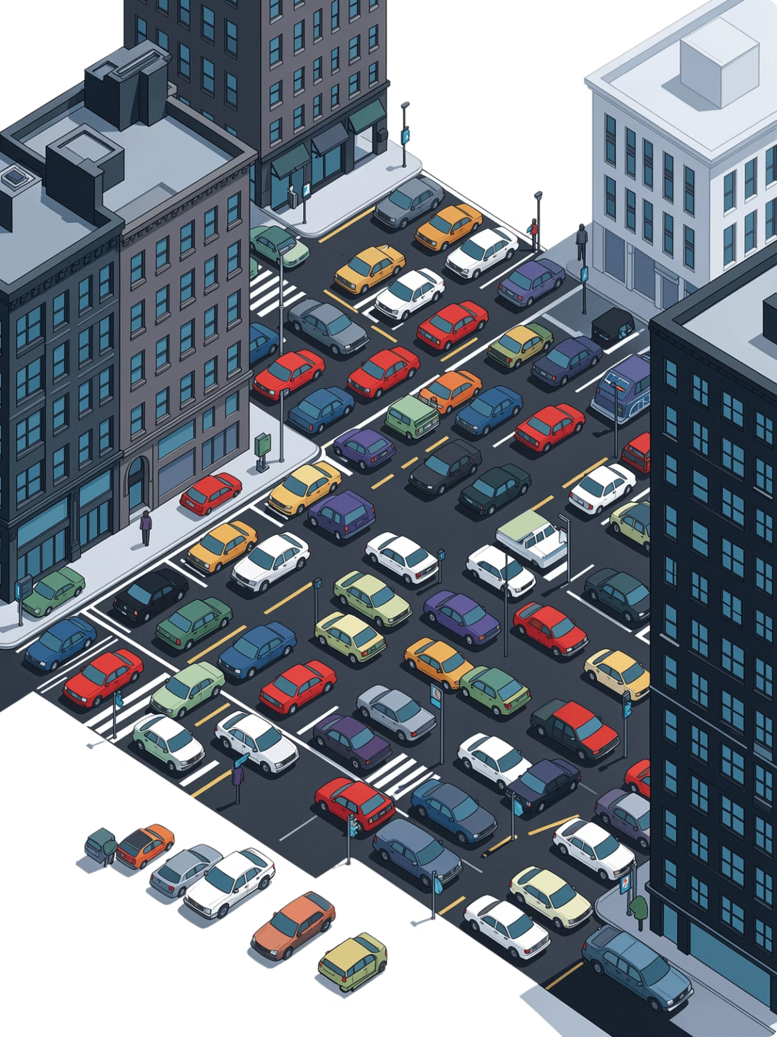
Problem Background
Application Domain
Smart City Transportation and Intelligent Parking Management.
AI- and data-driven urban mobility solutions.
Current Scenario
High-demand areas become congested while other parking spaces remain underutilized.
Drivers spend significant time searching for available parking.
Need for the Project
Introduce dynamic pricing based on real-time demand prediction.
Improve parking space utilization and city traffic management.
Target Users
Private vehicle owners.
Parking facility operators.

Slide 3
Problem Statement
Problem Definition
Develop a system that predicts real-time parking demand and dynamically adjusts parking prices to optimize parking utilization and reduce urban congestion.
Evidence / Statistics
Drivers spend 15–30% of urban travel time searching for parking.
Fixed pricing often leads to overcrowded parking facilities during peak hours.
Limitations of Current Systems
Static pricing does not adapt to changing demand.
Inefficient allocation of parking spaces.
Limited support for smart city parking management.
Expected Impact
Reduced traffic congestion and parking search time.
Increased parking revenue and support for sustainable smart cities

Slide 4
Project Objectives
Primary Goal: To develop a Dynamic Public Parking Pricing System that predicts real-time parking demand and dynamically adjusts parking prices.
1
2
3
Objective 1
Objective 2
Objective 3
[e.g., Achieve ≥90% demand prediction accuracy using historical and real-time occupancy data]
[e.g., Reduce average parking search time by ≥25% within the target zone]
[e.g., Deploy a responsive user notification system with latency under 5 seconds]
Scope: The project focuses on implementing a dynamic parking pricing system that uses real-time and historical parking data to predict demand and adjust parking fees accordingly.

Slide 5
Module Design
Input Layer: Parking occupancy, vehicle arrivals, historical demand, time, and location data
Processing Layer: Real-time demand analysis and prediction
Core Modules:
Demand Monitoring Module
Dynamic Pricing Engine Module
User Notification & Booking Module
Output Layer: Updated parking price, availability information, notifications, and booking confirmation
Goal: Optimize parking utilization, reduce congestion, and provide fair demand-based pricing
Flow:
Real-Time Data → Demand Prediction → Dynamic Pricing → User Notification → Parking Booking

Slide 6
Module 1:Demand Monitoring
Purpose :Continuously monitor parking demand and estimate the current occupancy level of each parking zone.
Key Functions
Collects real-time parking occupancy data
Tracks vehicle entry and exit rates
Monitors available parking spaces
Inputs
Number of occupied spaces
Number of available spaces
Arrival/departure rate
Output
Predicted Demand Level: Low / Medium / High

Slide 7
Module 2 :Dynamic Pricing Engine
Purpose : Automatically calculate parking fees according to predicted real-time demand.
Key Functions
Receives demand level from the Demand Monitoring Module
Predicts short-term parking demand
Applies predefined pricing rules
Example Pricing Logic
Demand Level | Occupancy | Pricing
Low | 0–40% | ₹20/hour
Medium | 41–70% | ₹30/hour
High | 71–100% | ₹45/hour

Slide 8
Module 3 : User Notification & Booking
Purpose : Provide users with real-time parking information and allow them to reserve available spaces.
Key Functions
Displays nearby parking locations
Shows available parking spaces
Displays current dynamic price
Sends price and availability notifications
User Interaction
Search Parking → View Availability → Check Dynamic Price → Select Slot → Book → Confirmation
Benefits
Reduces time spent searching for parking
Improves user convenience
Provides transparent pricing

Slide 9
Literature Survey
S.No | Year | Author(s) | Title | Key Contribution / Findings | Research Gap / Limitation
1 | 2022 | Ali & Shah | IoT-Based Smart Parking Monitoring System | Developed an IoT-enabled parking monitoring system using occupancy sensors and cloud connectivity for real-time parking availability. | Does not support dynamic pricing or parking demand prediction.
2 | 2023 | Zhang et al. | Machine Learning-Based Parking Demand Prediction | Applied machine learning algorithms to forecast parking demand using historical occupancy and traffic data. | Prediction accuracy decreases during special events and unexpected traffic conditions.
3 | 2023 | Zhou & Lee | Dynamic Parking Pricing Using Demand–Supply Analysis | Proposed a demand-based pricing model to optimize parking occupancy and improve revenue. | Relies mainly on historical data; ignores real-time weather and event information.
4 | 2024 | Sarker et al. | Smart Parking Management System with IoT Integration | Integrated IoT sensors, mobile applications, and cloud services for real-time parking management and monitoring. | High deployment cost and limited scalability for large metropolitan cities.
5 | 2024 | Mabrouk et al. | Deep Learning-Based Parking Demand Forecasting | Utilized deep learning models to predict parking demand and recommend optimal pricing strategies. | Requires large datasets and high computational resources for training.

Slide 10
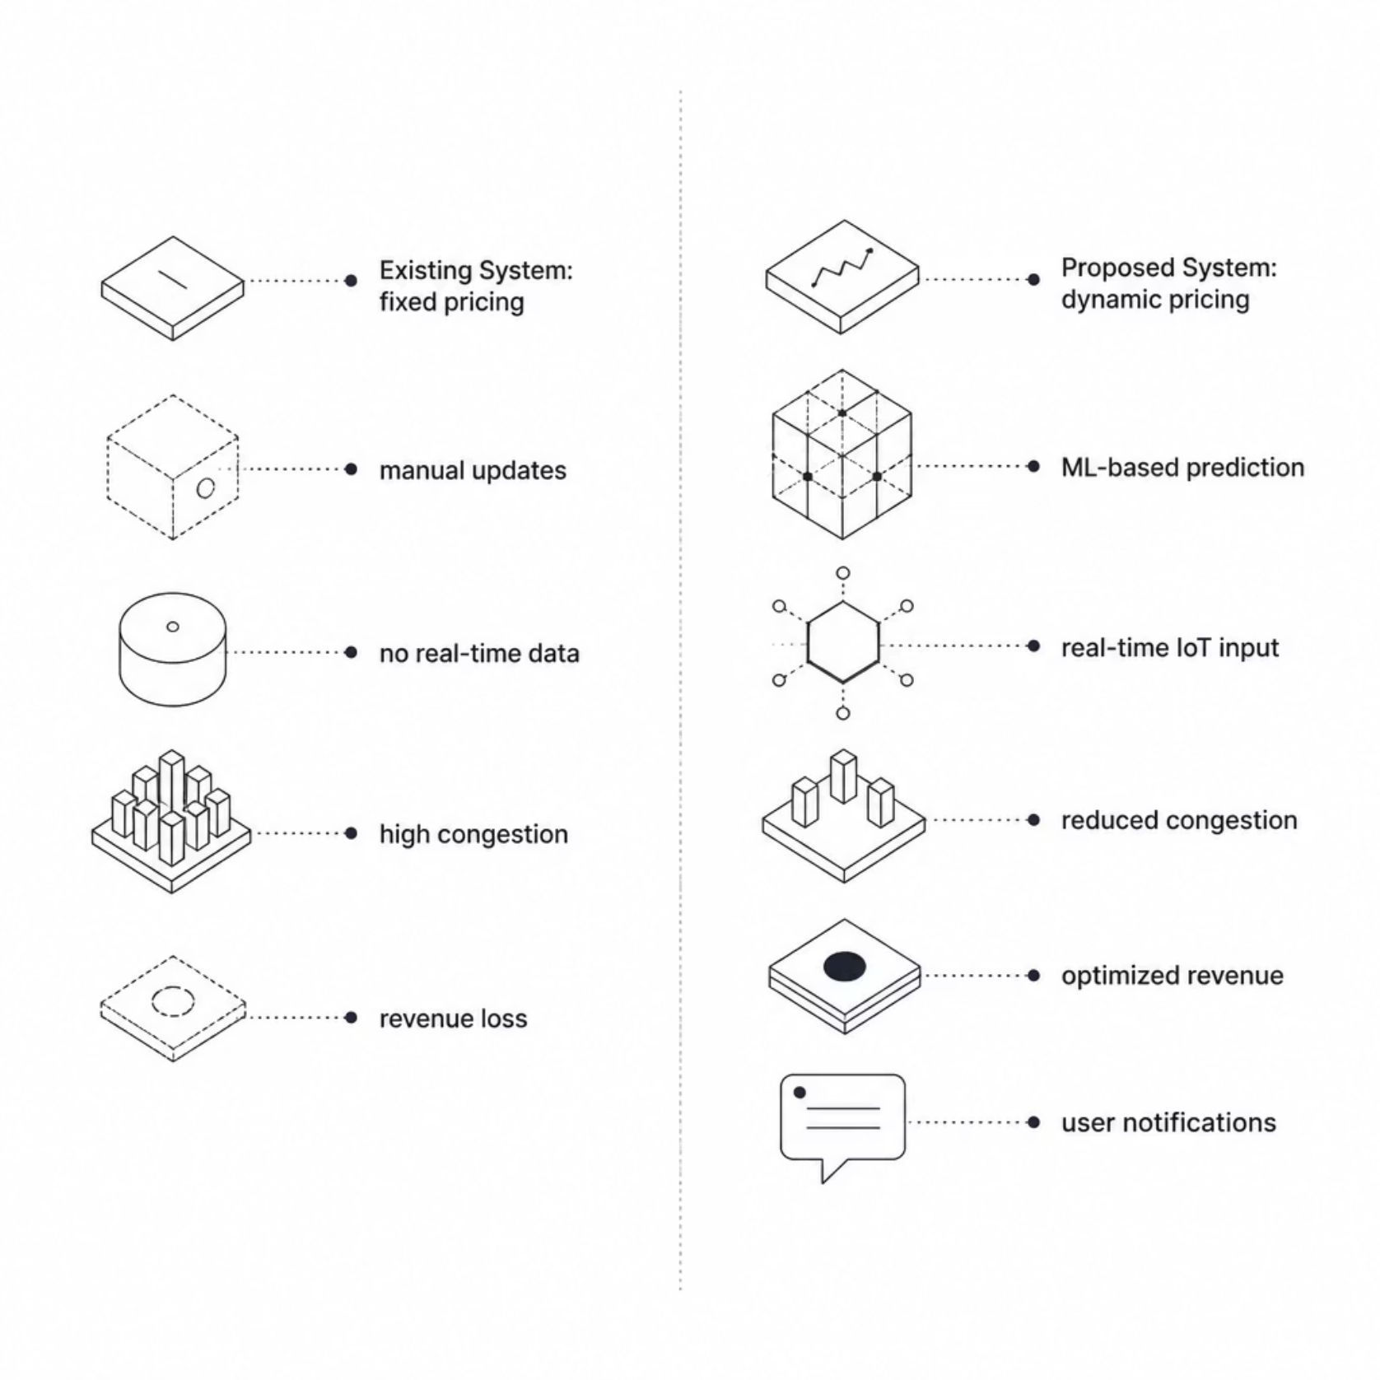
Existing vs. Proposed System
Current Approach:
Novelty:
Traditional public parking systems use fixed pricing without considering real-time demand, leading to inefficient parking utilization and increased traffic congestion.
Uses real-time parking demand prediction instead of static pricing.
Dynamically adjusts parking fees based on occupancy, demand, and time.

Slide 11
System Requirements
Functional Requirements
Non-Functional Requirements
Hardware & Software Stack
Real-time demand prediction from live sensor feeds
Automated dynamic price adjustment per zone/lot
User notifications via mobile app / display boards
Scalable architecture supporting N+ parking zones
System latency < 5 seconds end-to-end
99.5% uptime SLA for production deployment
Hardware: [Sensors, edge devices, servers, IoT gateways]
ML Frameworks: [TensorFlow, scikit-learn, PyTorch]
Databases: [ PostgreSQL, InfluxDB, Redis]
Data Sources: [Occupancy feeds, traffic APIs, weather data]

Slide 12
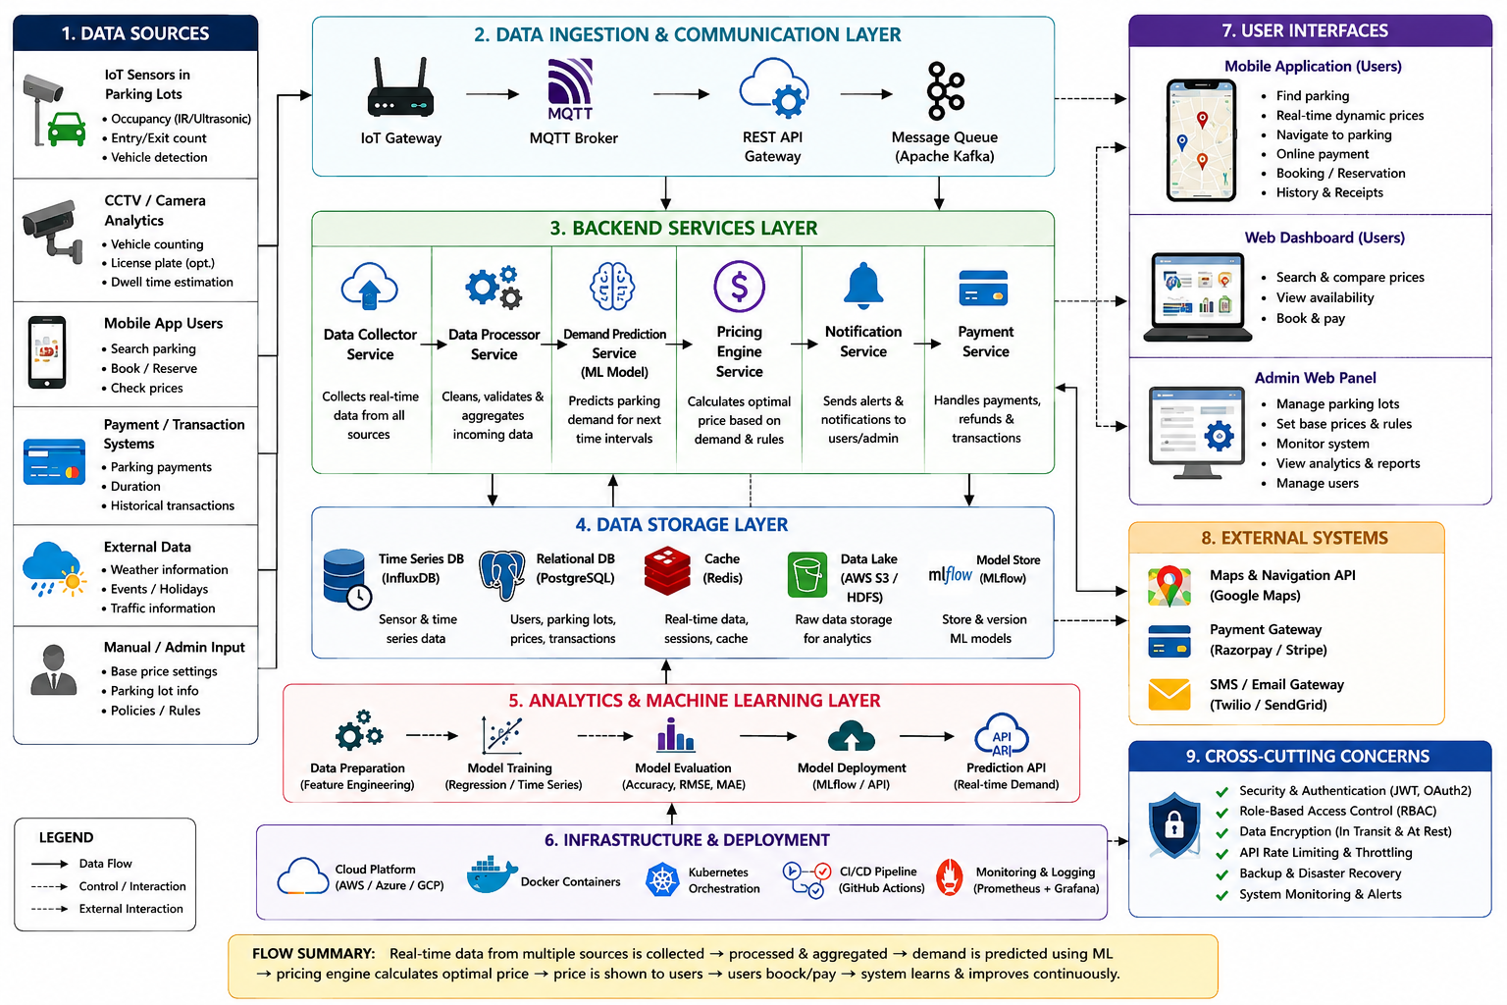
System Architecture

Slide 13
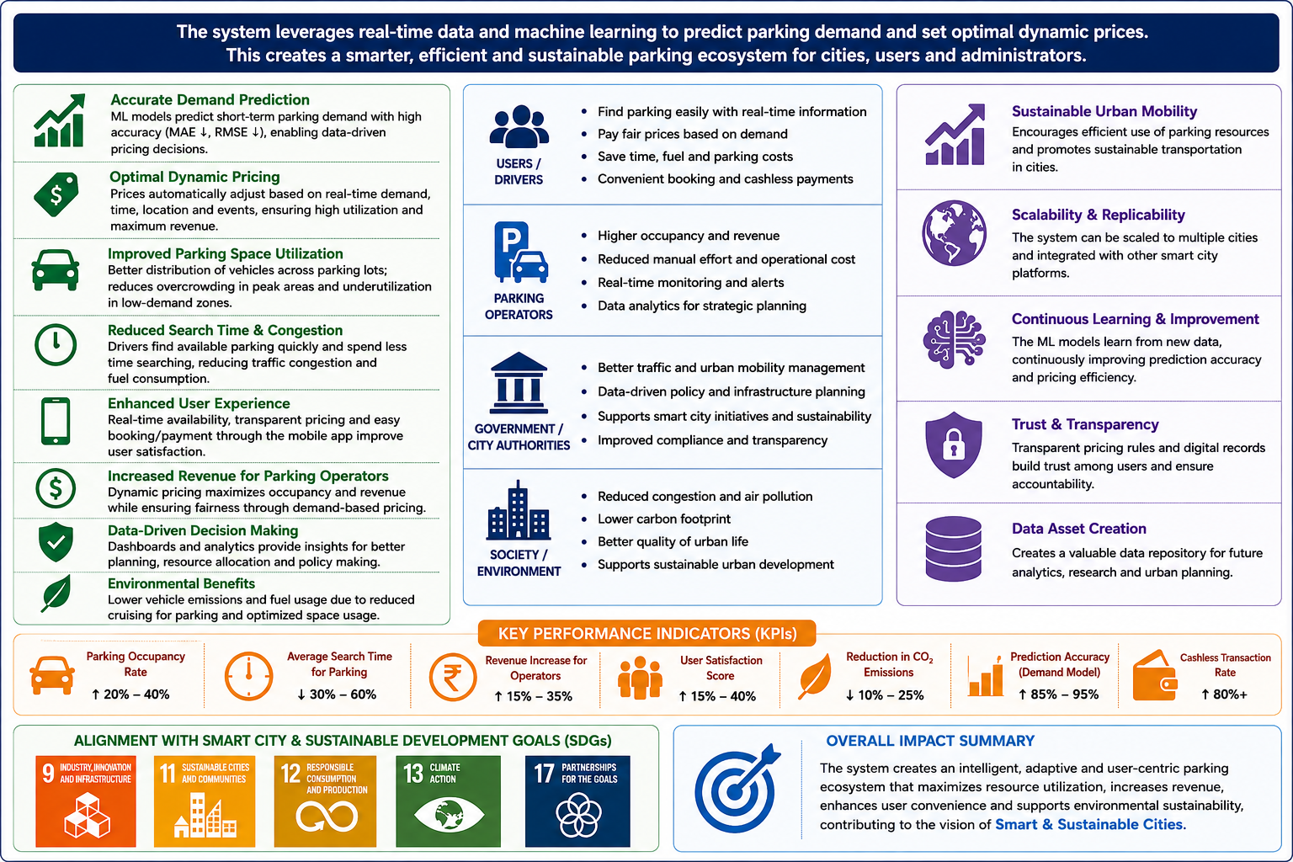
Expected Outcomes & Impact
Deliverables
Benefits
Fully functional dynamic pricing system
Trained and validated ML demand prediction model
Research paper and technical documentation
Reduced parking search time for drivers
Optimized parking revenue for city authorities
Lower vehicle emissions from reduced cruising
Future Work
Multi-city and multi-zone deployment at scale
Integration with autonomous vehicle routing systems
[Additional extensions — EV charging, public transit linkage]

Slide 14
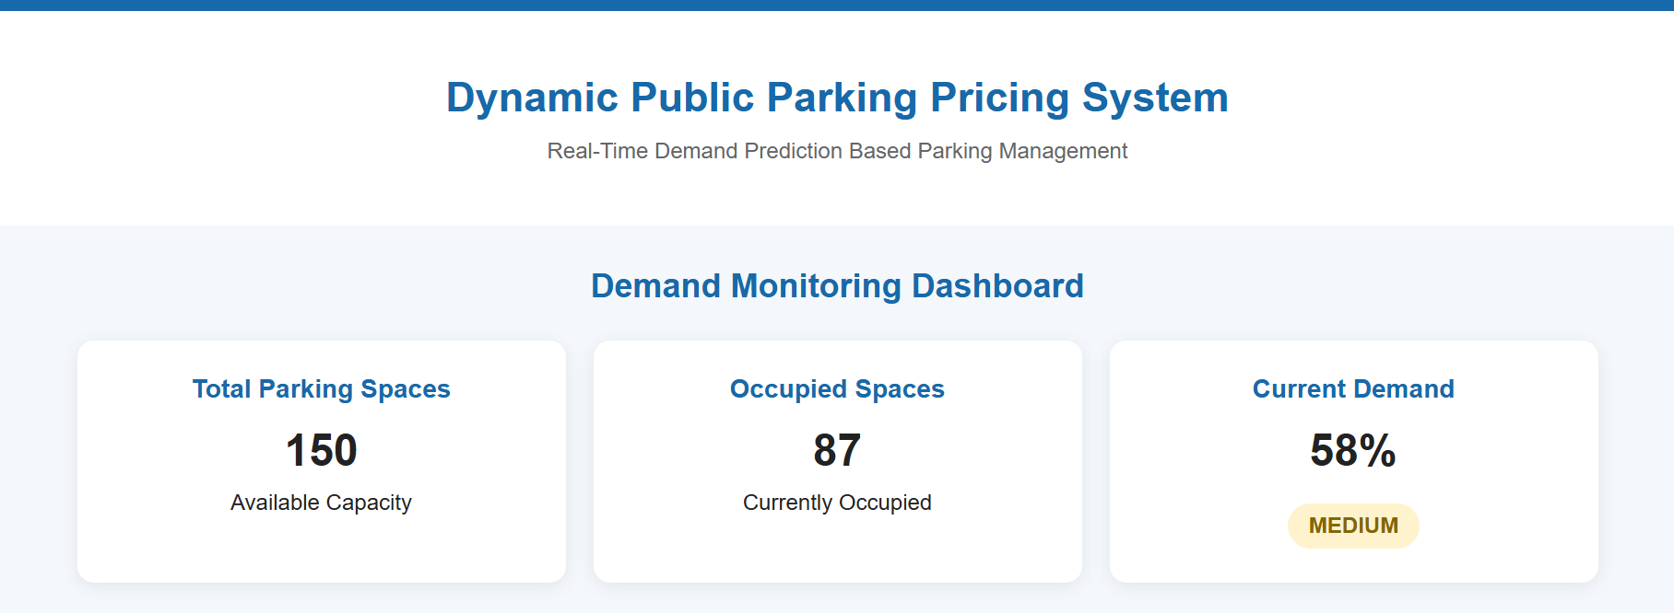
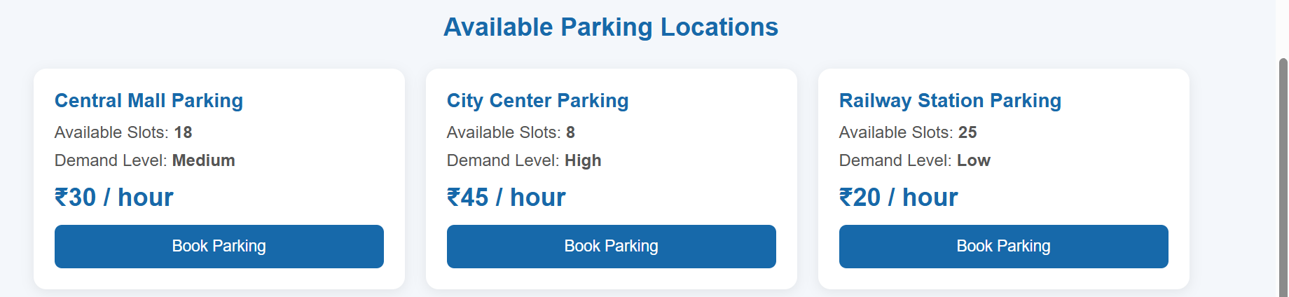
Implementation

Slide 15


